Slide 1
Nashville Metro Scooters
DA11 Hot Honey: Adell Daly, John Michael Capps, Jonathan McNutt, Melissa Quarles, Savannah Williams

Slide 2
Navigating Nashville Scooter Data
Deliverables
01
Determine ideal density of available scooters
Second Substitute Bill BL2018-1202
03
All permitted operators will first clean data
Scooter Data
02
Subset of 3 months of data, over 7 million observations
SUMDs
05
Shared urban mobility devices
Pilot Program
04
7 companies participated
Notes:
In the summer of 2018, Bird scooters, a now well-recognized emblem of the city of Nashville, were dumped on the street prompting the city of Nashville to sue where they subsequently won and Bird was forced to remove their scooters.
This is elicited a one-year pilot program to be launched in 2019 by the Metro Council in which 7 companies participated. Those 7 companies include Bird, Bolt, Gotcha, Jump, Lime, Lyft, and Spin
As part of the pilot program, Metro Council enacted Second Substitute Bill BL2018-1202 which required all operators to clean their data prior to providing or reporting it to Metro. Processing and cleaning includes removal of staff servicing and rest trips, removal of trips below one minute, and trip lengths are to be capped at 24hrs
The data set was presented in two separate tables, one containing information specific to each individual scooter titled scooters, and another for each trip that was recorded for each scooters titled trips. Additionally, in the scooters table, each scooter reports its location every five minutes and this is recorded as an entry. Between these two data set, the observations recorded amounted to over 7 million entries.
Through this presentation, we will exhibit our analysis of the scooter data set by answering the questions of whether or not the previously mentioned scooter companies complied with the required data cleaning outlined in Second Substitute Bill BL2018-1202, what the typical usage patterns of for scooter are in respect to time, location, and trip duration, and what would be recommended for total number of scooter overall.

Slide 3
Boot n’ Scoot Through Nashville
Compliance
Usage patterns
Recommendations
What companies were in compliance with the bill passed by metro
Usage patterns in regards to time, duration, location
Appropriate number of scooters for the city as well as zip
01
02
03

Slide 4
Scooter Companies
Spin
Gotcha
Jump
Bird
Lyft
Bolt
Lime

Slide 5
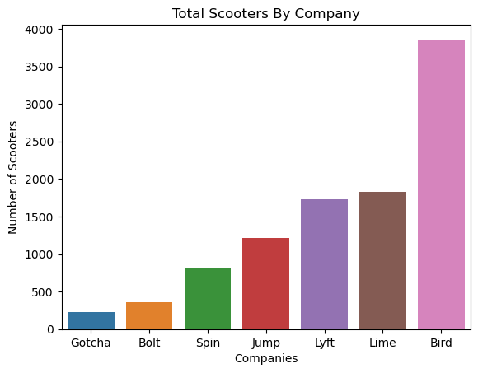
Deployed

Slide 6
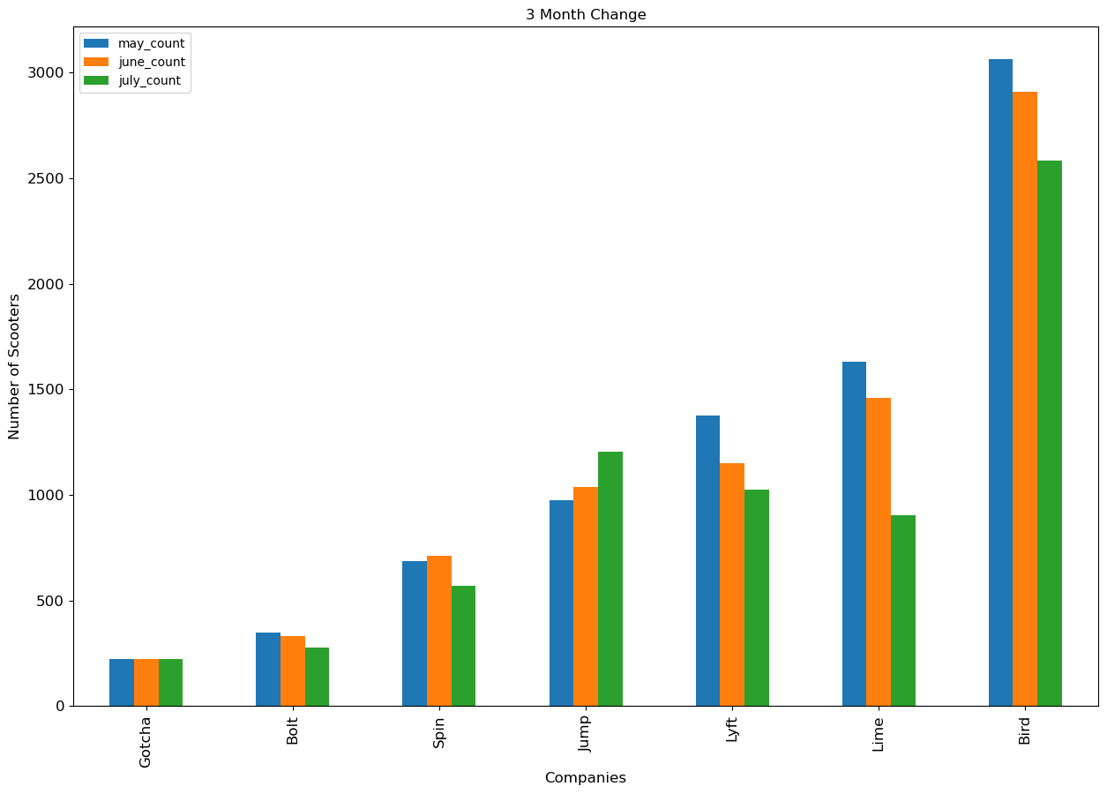
Changing Direction

Slide 7
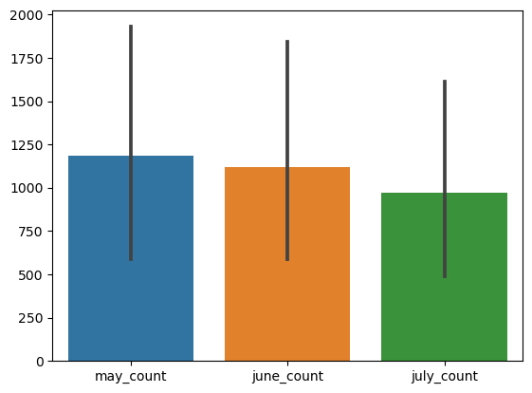
Changing Direction

Slide 8
Second Substitute Bill BL2018-1202
All permitted operators will first clean data before providing or reporting data to Metro. Data processing and cleaning shall include:
Removal of staff servicing and test trips
Removal of trips below one minute
Trip lengths are capped at 24 hours

Slide 9
Compliance with Second Substitute Bill BL2018-1202
Over 24 Hours
Bolt
Spin
Lyft
351 trips over 24 hours not removed
28 trips over 24 hours not removed
2 trips over 24 hours not removed
Notes:
So how much can we trust these scooter companies? Based on adherence to Second Substitute Bill BL2018-1202 [assed by metro,

Slide 10
Compliance with Second Substitute Bill BL2018-1202
Under 1 minute
Lyft
Bird
Lime
1329 under 1 minute not removed
1229 trips under 1 minute not removed
383 under 1 minute not removed
Notes:
So how much can we trust these scooter companies? Based on adherence to Second Substitute Bill BL2018-1202 [assed by metro,

Slide 11
Scooter Density
Location
37203 had the largest number of scooters used
What does this look like?
Ride over to the next slide for visualizations!
Day
Saturday is most popular day for scooter use
Hour
The night time hours sustain for more frequent scooter use
Notes:
The night time hours had a higher volume of scooter use, with 11pm being the overall peak hour.

Slide 12
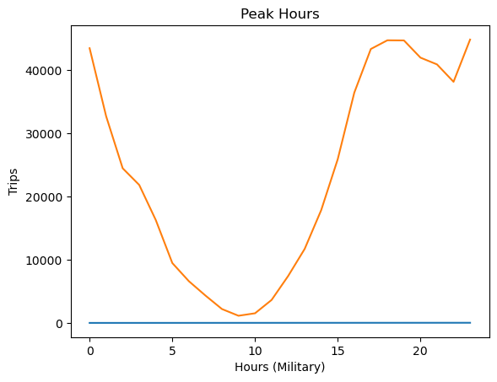
Is Taco Bell Open?

Slide 13

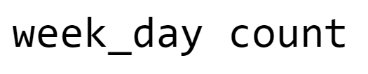
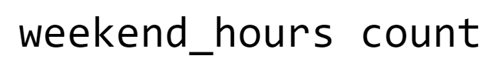
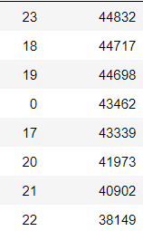
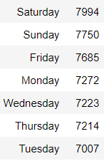
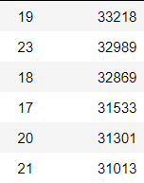

Slide 14
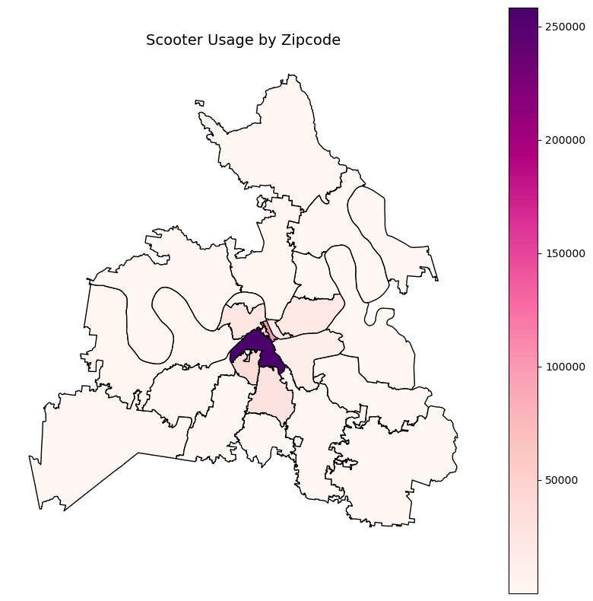
Scooter Usage by Zipcode
37203
37201
37219

Slide 15
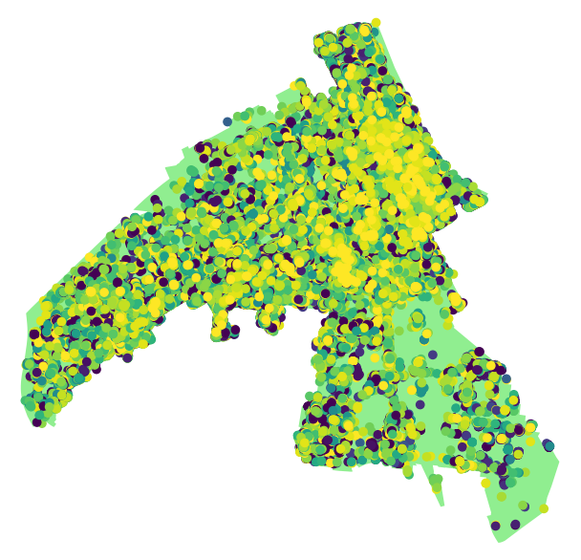
Scooter Trips Start Points 37203

Slide 16
Roadmap Infographics
01
Bird
June 29, 2019
1566
Bird
June 30, 2019
1546
02
Bird
03
June 8, 2019
1513
Bird
May 26, 2019
1483
04

